Slide 1

Degrees of accuracy
Task A: Understanding degrees of accuracy
1) Complete the table to show the most appropriate degree of accuracy:
 | Nearest integer | Nearest ten | Nearest hundred | Nearest thousand
The number of baked beans in a tin
The height at which a plane flies
Number of seats in 5 cinema screens
The number of people living in a street
Number of pages in a book
Number of buckets of water to fill a paddling pool
The number of grains of rice in 1 kg
2) Complete the table to show which degree of accuracy is most likely to have been used:
 | 1 s.f. | 2 s.f. | 3 s.f. | 4 s.f.
The population of a town is 12 000
The length of a plank of wood is 6.24 m
The width of a blade of grass is 1.6 mm
The attendance at a pop concert is 30 000
62% of UK homes own a pet
The width of a human hair is 0.009 cm
The distance from Earth to the Moon is 384 400 km

Slide 2

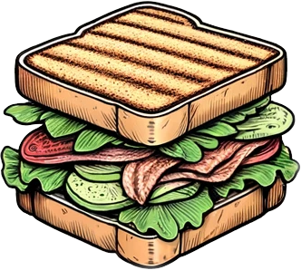
Degrees of accuracy
3) Rewrite the story below rounding each of the numbers to an appropriate degree of accuracy.
Sofia belongs to a supporters club for her favourite football team. They decide to organise coaches to watch an away match. 20 coaches of 50 people set off for the match. The coach travels 260 km to the match which takes them 4 hours. Whilst at the match Sofia and her mum buy some lunch which costs £20. During the match there was an announcement that the attendance at the match is 52 000. The average speed of the coach on the way home is 55 mph. And they arrive home at 12am.
Task B: Answers to an appropriate degree of accuracy
In each of the following questions give your answers to an appropriate degree of accuracy.
1) Calculate the area and perimeter of the following:
a)
b)
5.2 cm
Perimeter = 2 × 5.2 + 3.4
= 13.8 cm
Area = ½ × 3.4 × 4.9
= 8.3 cm² (to 1 d.p.)
4.9 cm
3.4 cm
Perimeter = 2 × (1.28 + 3.65)
= 9.86 m
Area = 1.28 × 3.65
= 4.67 m² (to 2 d.p.)
1.28m
3.65m
2) Convert the following from dollars into pounds:
Using the exchange rate £1 : $1.27
a)
b)
£ | $
1 | 1.27
2.32 | 2.95
$2.95
$2.95
$5.70
£ | $
1 | 1.27
4.49 | 5.70
‹#›

Slide 3
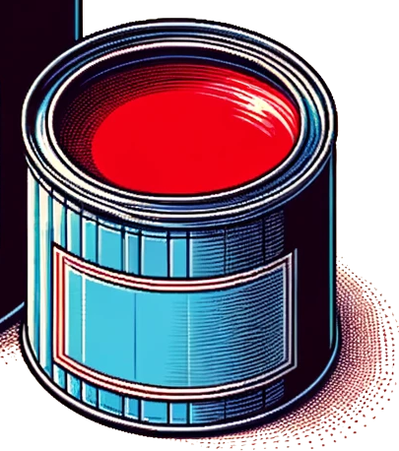
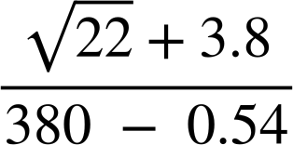
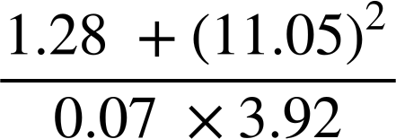
Degrees of accuracy
3) Answer the following. At each stage give your answer to an appropriate degree of accuracy.
How much will it cost to paint this wall?
1 tin of paint covers 25 m².
£19.50
2.5 L
4 m
Area of wall = 50.47 m²
Number of tins of paint = 50.47 ÷ 25
= 2.018…
= 3
Cost of paint = 3 × 19.50
= £58.50
6.84 m
5.35m
8.25m
4) Use you calculator to answer the following:
a)
b)
0.022 (to 2 s.f.)
449.64 (to 2 d.p.)
Mathematics in Education and Industry
v2.3

